Slide 1
Master Thesis
Semantic Segmentation of Land Use with High-Resolution Orthophotos and Convolutional Neural Networks
Faculty of Mathematics and Computer Science
Karsten Köhler, Student ID No. 8690570

Slide 2
Content
Image Segmentation
Vegetation Analysis
Literature Review
Convolutional Neural Network
Reference Architectures
Dataset
Raster Preprocessing
Label Preparation
Experiments
Implementation
Metrics
Segmentation Results
Discussion
Literature Review
Spectral Vegetation Indices
Experiments
Implementation
Visualizations
Discussion

Slide 3
Research Question
Background: Emergency Landing Assistant, Emergency Landing Field Identification
Primary Objective: Semantic Segmentation of Land Use
Side Objective: Vegetation Density Analysis

Slide 4
Image Segmentation
Literature Review
Faculty of Mathematics and Computer Science
Karsten Köhler, Student ID No. 8690570

Slide 5
Convolutional Neural Networks
Subset of Neural Networks
Highly efficient on grid-like data like e. g. images
Two common operations:
Convolution
Pooling

Slide 6
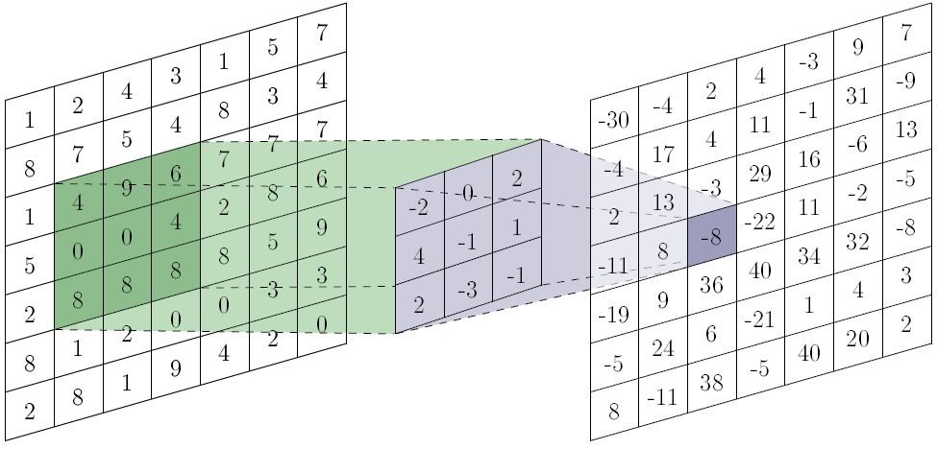

Convolution
Filter, move across image, learns shared parameters
hyperparameters: size, padding, stride
Produces convolved image (feature map)
https://towardsdatascience.com/a-comprehensive-guide-to-convolutional-neural-networks-the-eli5-way-3bd2b1164a53

Slide 7
Convolution
Multiple filters per convolution layer
Apply filters to previous feature maps
Filters can have depth
lots of computations required
Filters
Filters
Input
Feature Maps
Feature Maps

Slide 8
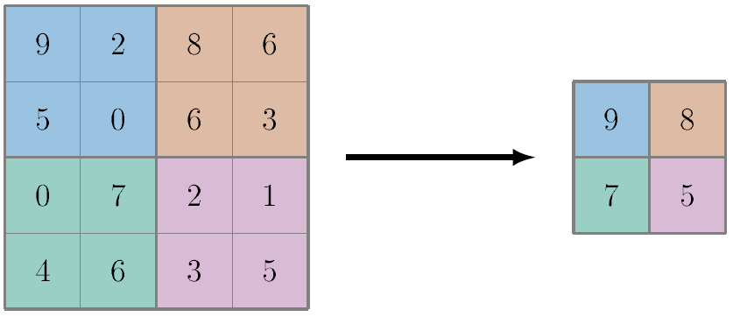
Pooling
Reduce spatial size
no trainable parameters
hyperparameters: size, padding, stride
Max Pooling

Slide 9

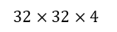

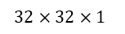
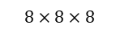
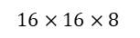
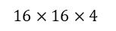
Example CNN Architecture
Alternating Convolution/Pooling Layers
Extract high-level features, computationally manageable
Only class predictions, no segmentation so far
FCN by omitting fully-connected layer, result is low-resolution heatmap
$$32×32×1$$
$$32×32×4$$
$$16×16×8$$
$$8×8×16$$
$$1×1×k$$
$$16×16×4$$
$$8×8×8$$
Conv.
Pool.
Conv.
Pool.
Conv.
Full
Class Predictions
Input Image

Slide 10
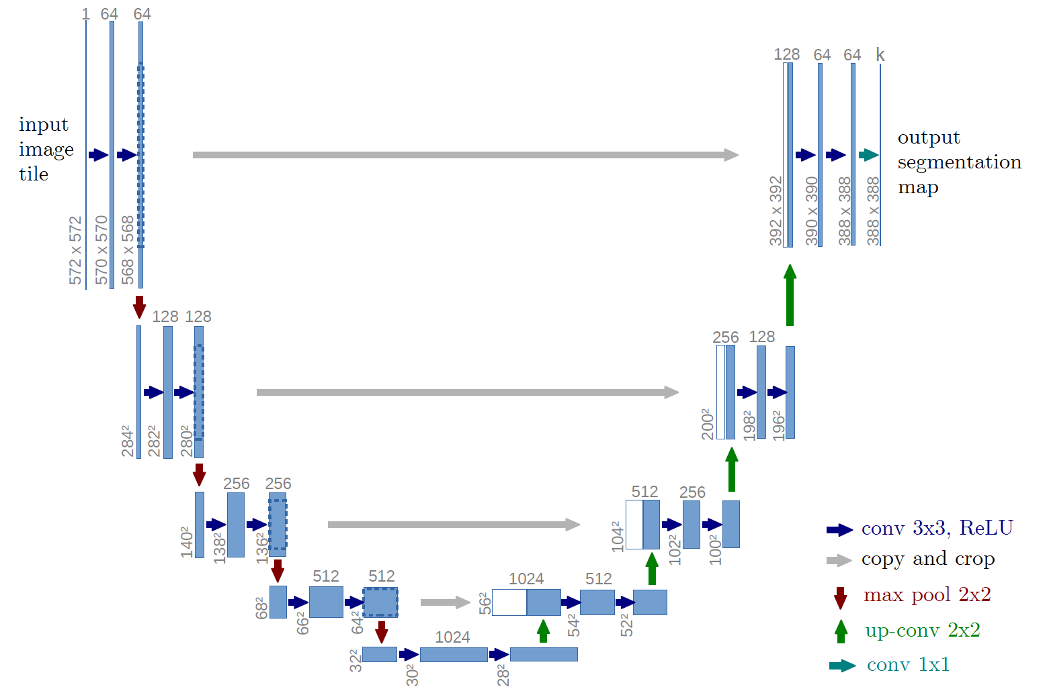
U-Net Architecture
contracting and expanding path
skip connections between paths
segmentation map is smaller than input image

Slide 11
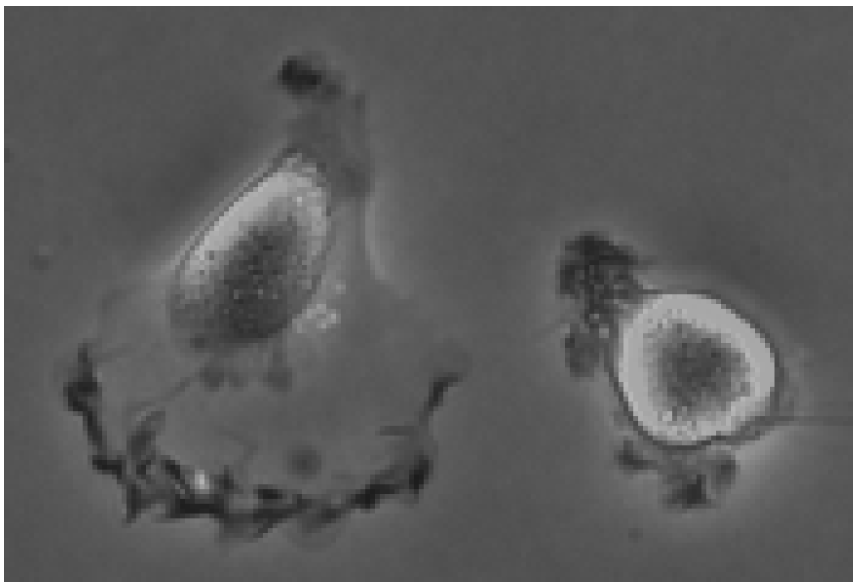
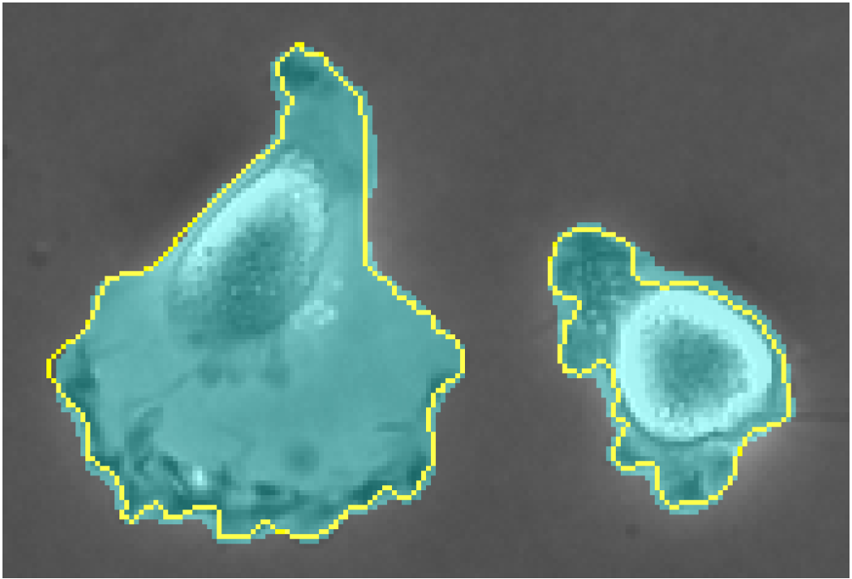
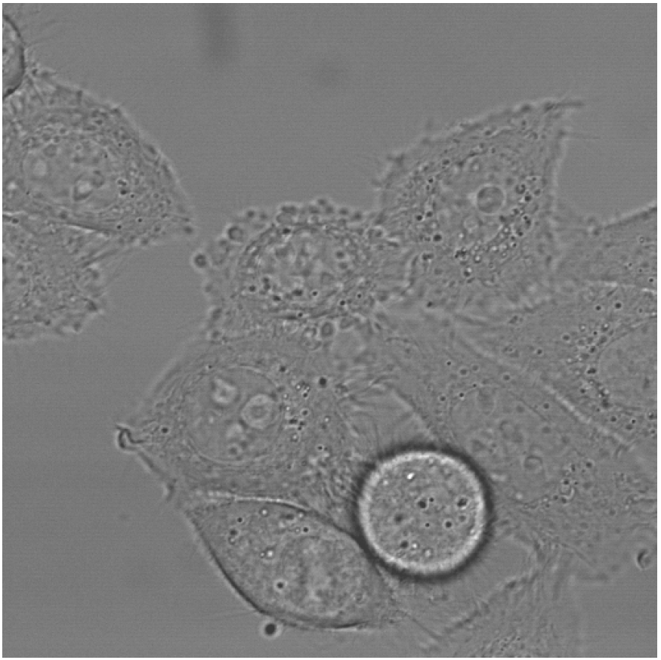
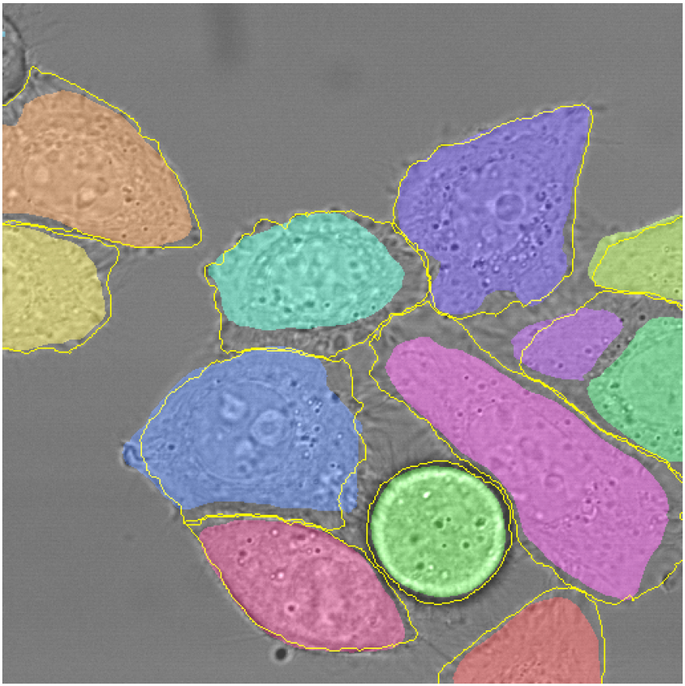
U-Net on ISBI Cell Tracking Challenge 2015
DIC-HeLa 77.56% average IoU
PhC-U373 92.03% average IoU

Slide 12
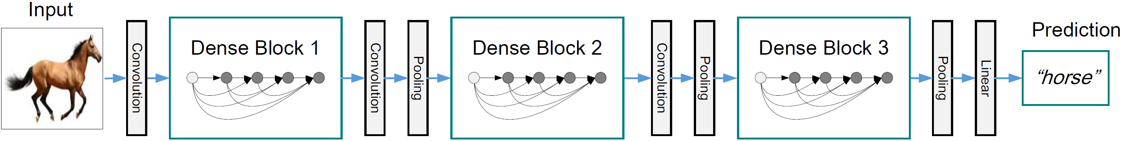
DenseNet Architecture
originally designed for image classification
introduced components called Dense Blocks
dense connectivity increases information flow and computational efficiency

Slide 13
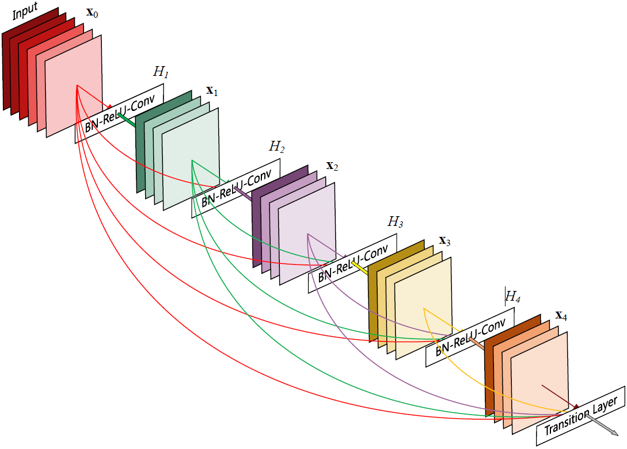
DenseNet Architecture – Dense Blocks
direct connections to all subsequent layers
growth rate determines new feature maps per step
transition layer at the end for downsampling
optional: compression in transition layer

Slide 14
FC-DenseNet Architecture
Input
Output
Layers | Feature Maps
Input | 3
3x3 Convolution | 48
Dense Block (4) + Transition Down | 112
Dense Block (5) + Transition Down | 192
Dense Block (7) + Transition Down | 304
Dense Block (10) + Transition Down | 464
Dense Block (12) + Transition Down | 656
Dense Block (15) | 896
Transition Up + Dense Block (12) | 1088
Transition Up + Dense Block (10) | 816
Transition Up + Dense Block (7) | 578
Transition Up + Dense Block (5) | 384
Transition Up + Dense Block (4) | 256
1x1 Convolution | c
Convolution
Convolution
Dense Block
Dense Block
C
Skip Connection
C
Transition Down
Transition Up
Dense Block
Dense Block
C
Skip Connection
C
Transition Down
Transition Up
Dense Block

Slide 15
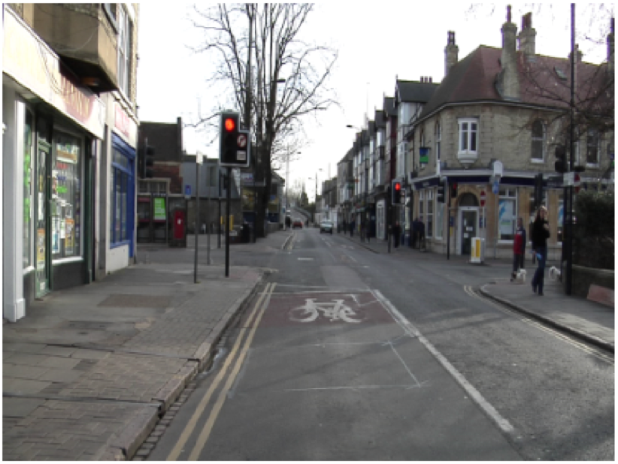
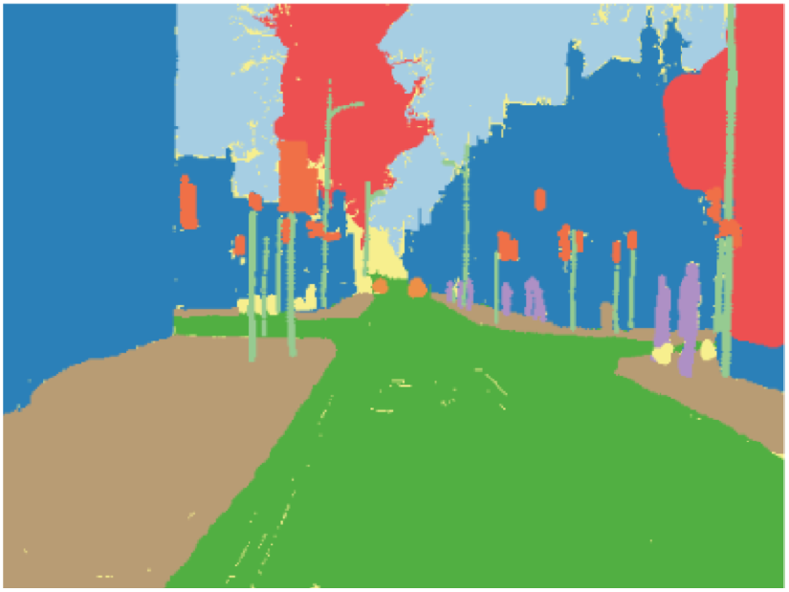
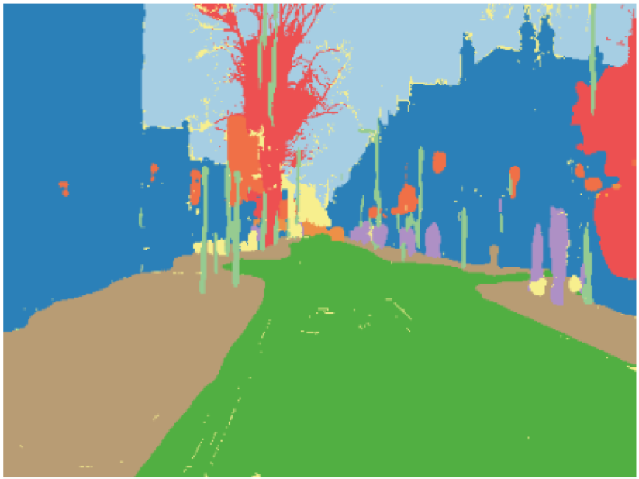
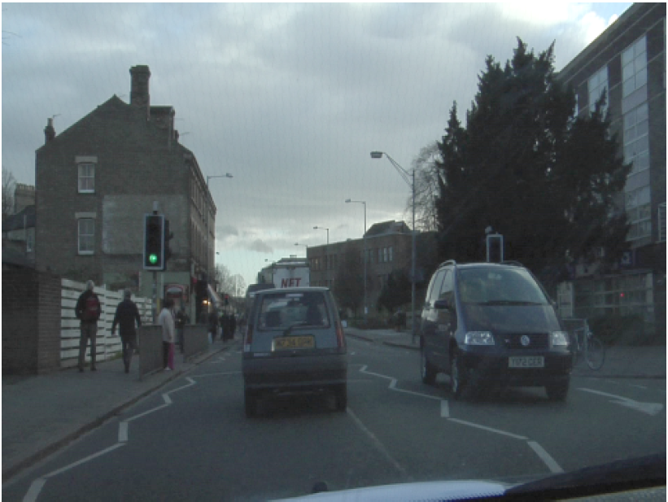
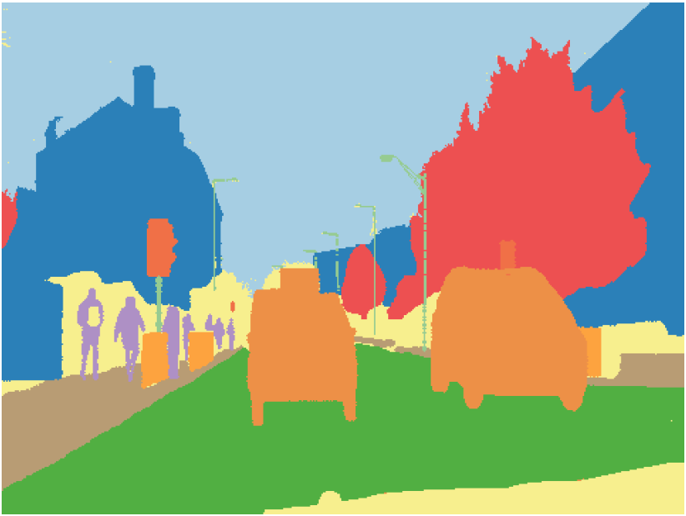
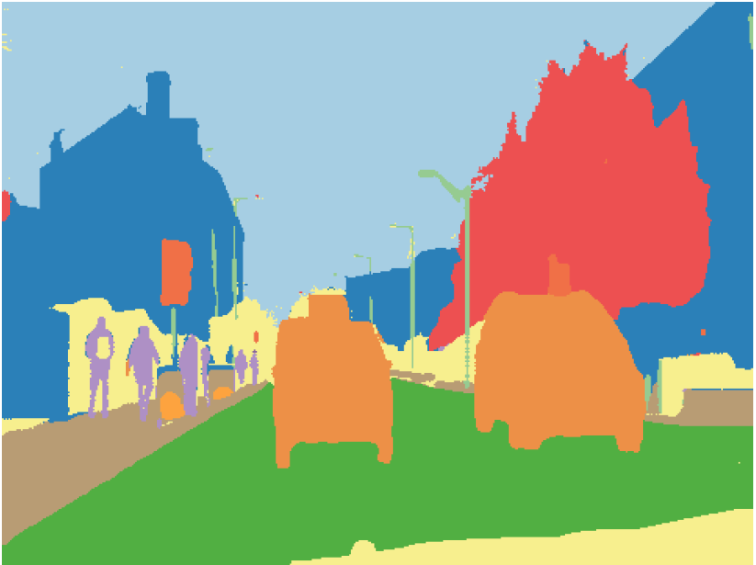
FC-DenseNet on CamVid Dataset
 | Parameters (M) | Mean IoU (%) | Gl. Accuracy (%)
Model
FC-DenseNet56 | 1.5 | 58.9 | 88.9
FC-DenseNet67 | 3.5 | 65.8 | 90.8
FC-DenseNet103 | 9.4 | 66.9 | 91.5
Original Image
Ground Truth
Prediction

Slide 16
W-Net Architecture
unsupervised learning approach
split into encoder and decoder parts
only encoder is used for inference
Postprocessing with Conditional Random Fields and Hierarchical Segmentation

Slide 17
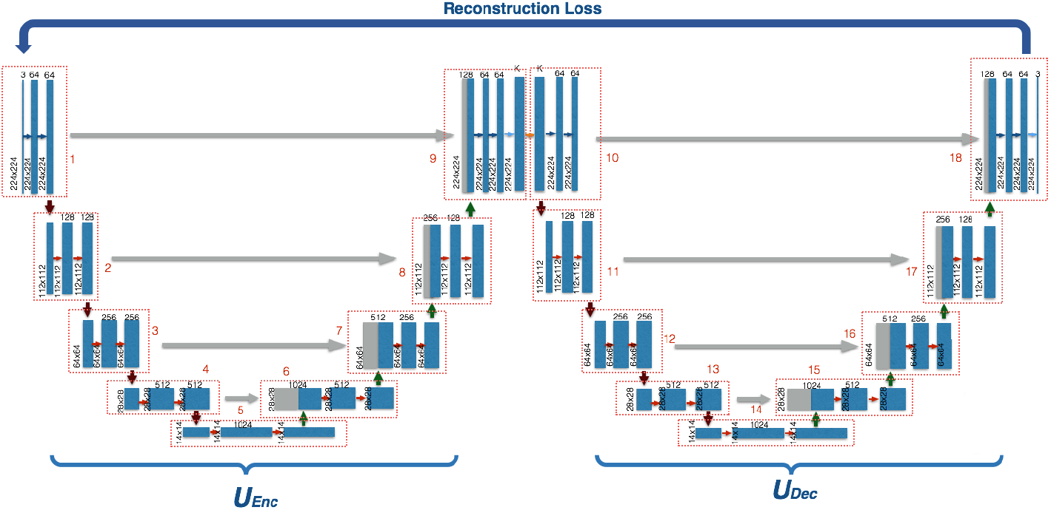
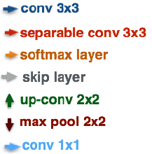
W-Net Architecture

Slide 18
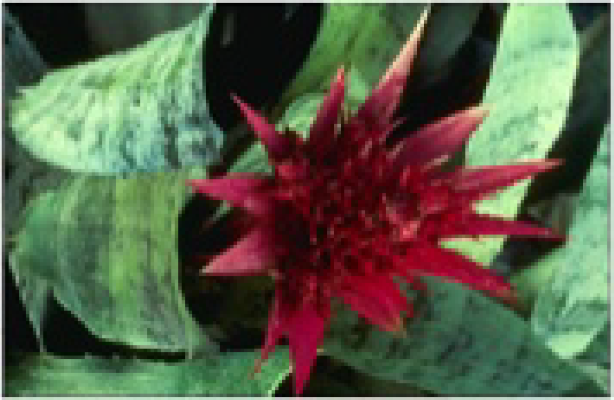
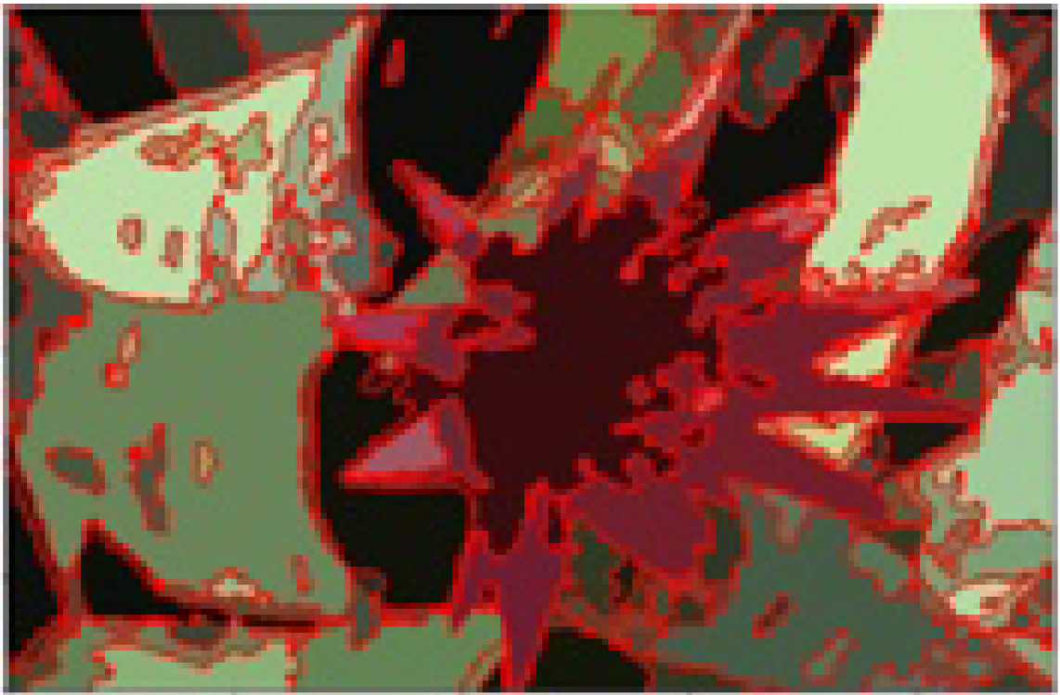
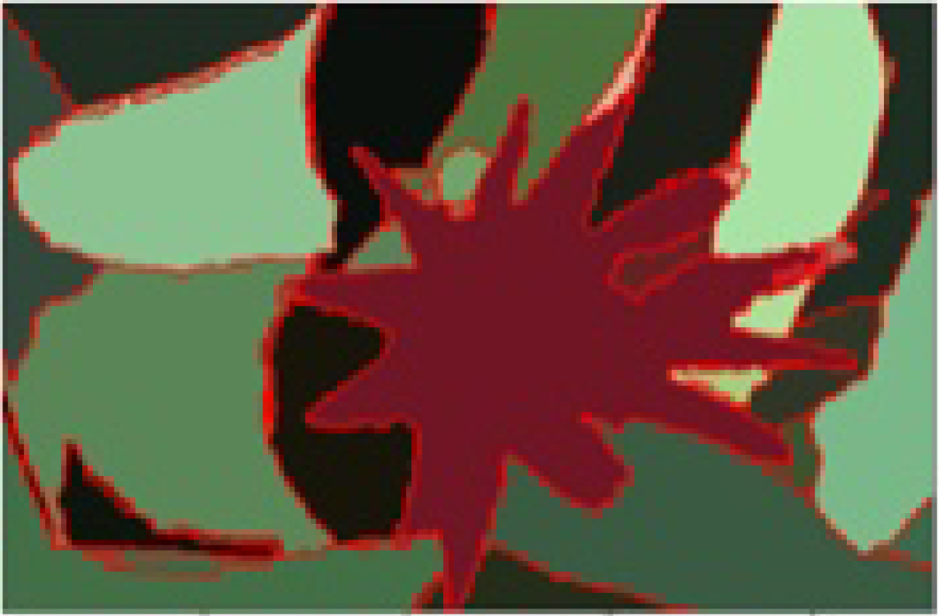
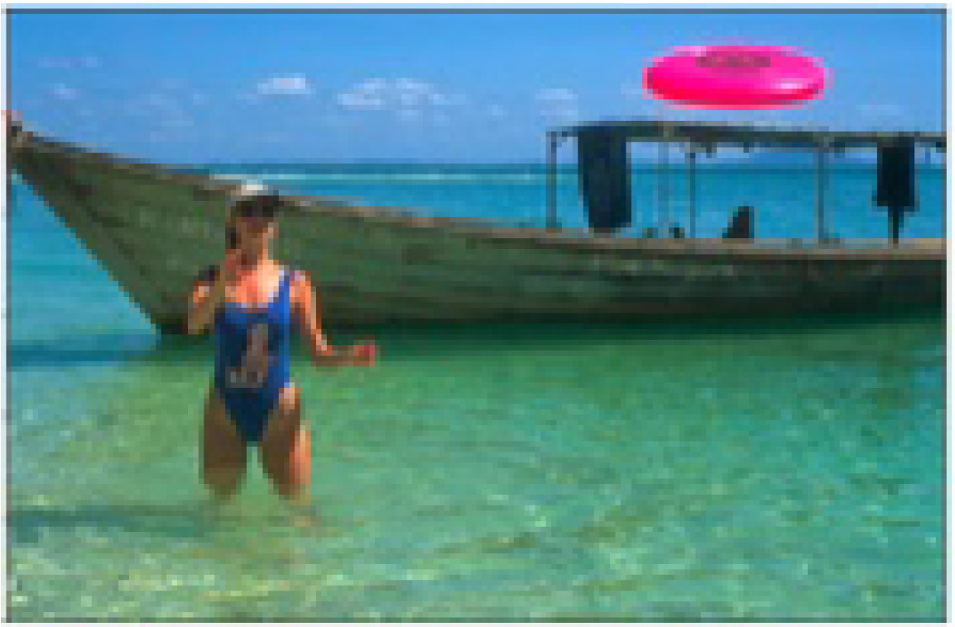
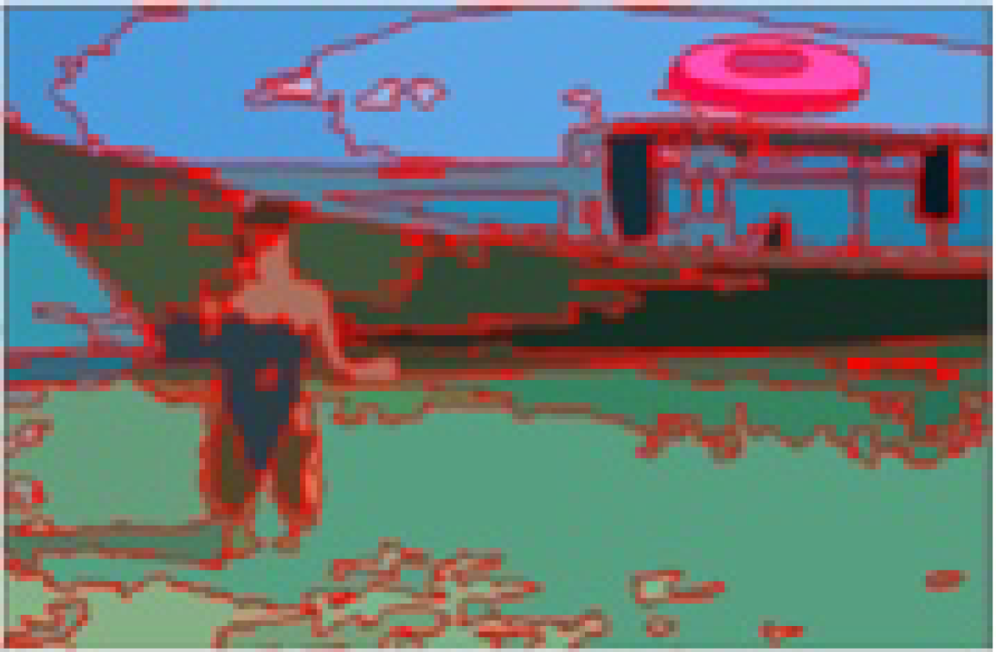
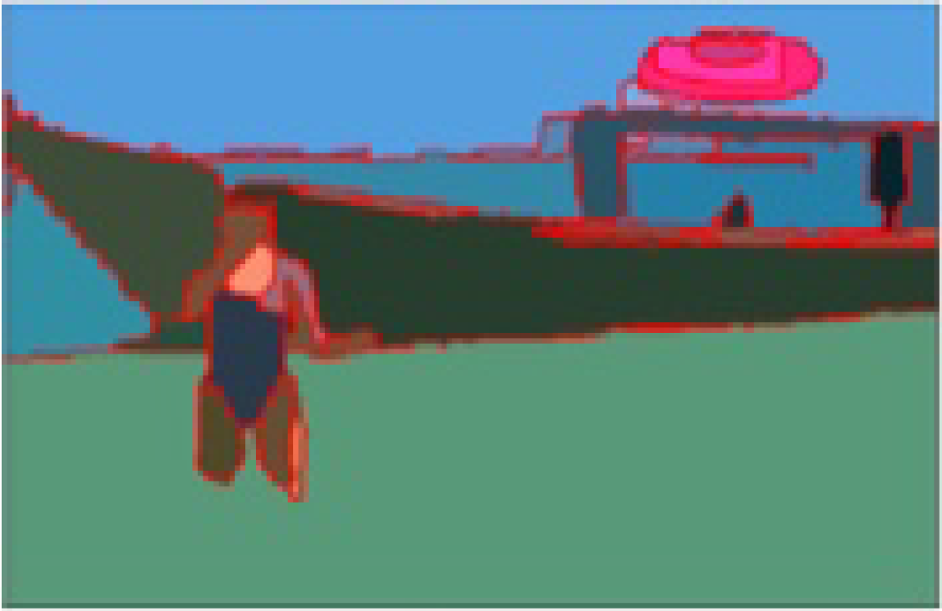
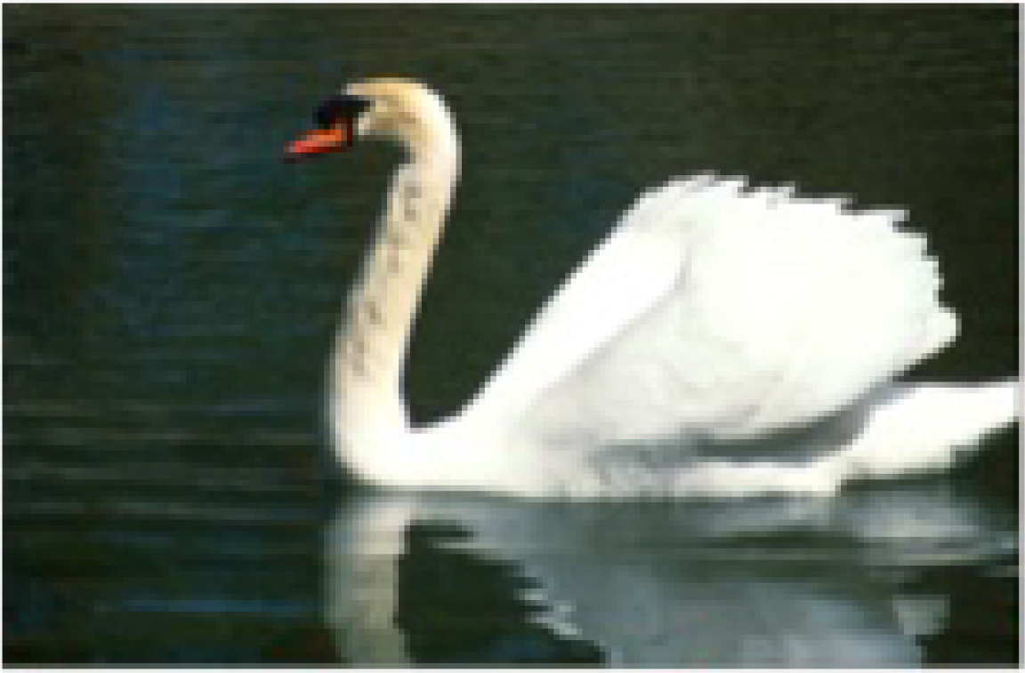
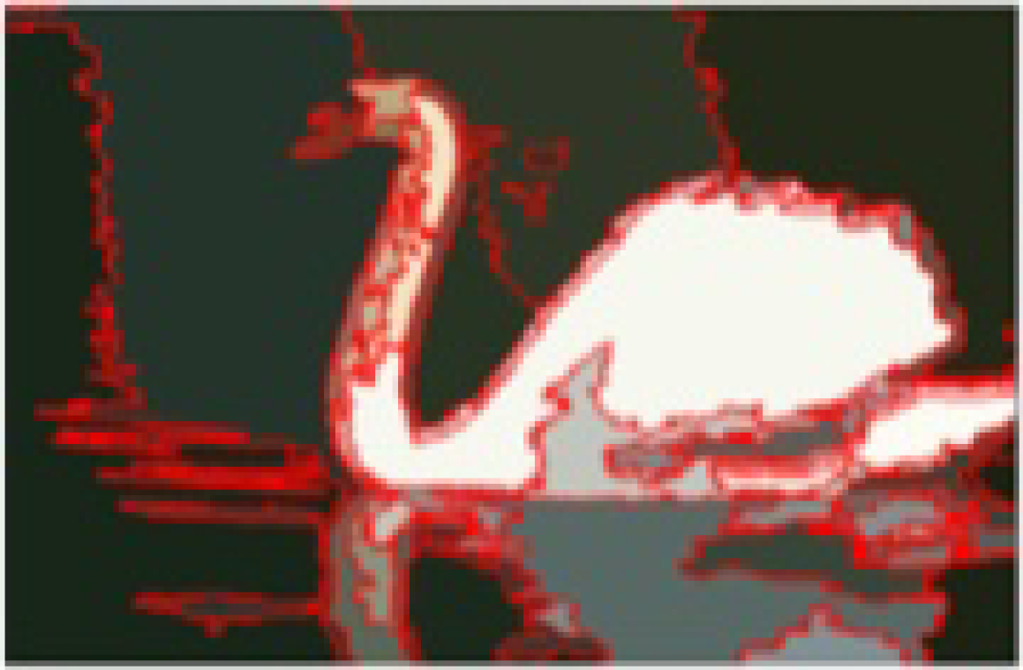
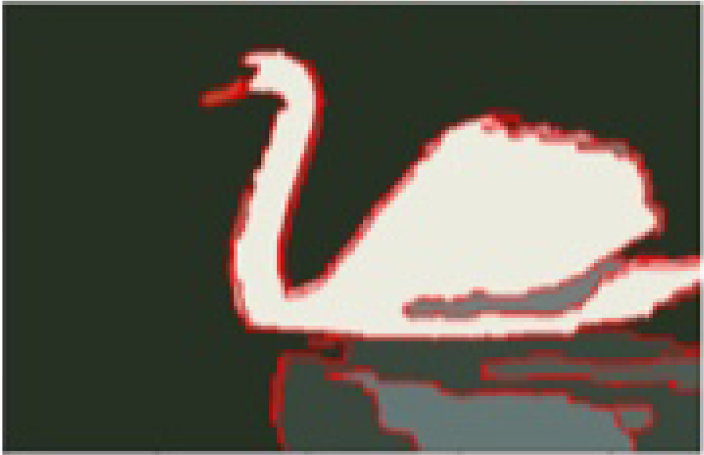
W-Net on BSDS500
Model | Segmentation Covering | Probabilistic Rand Index | Variation of Information
W-Net | 0.62 | 0.84 | 1.60
W-Net + PP | 0.64 | 0.85 | 1.47
Original Image
W-Net Prediction
After Postprocessing

Slide 19
Image Segmentation
Dataset Preparations
Faculty of Mathematics and Computer Science
Karsten Köhler, Student ID No. 8690570

Slide 20
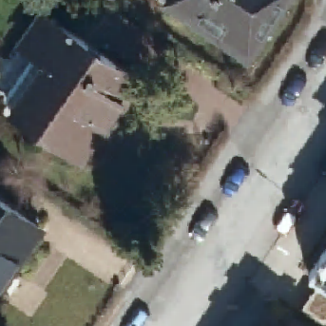
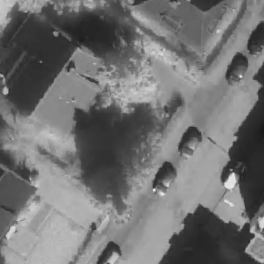
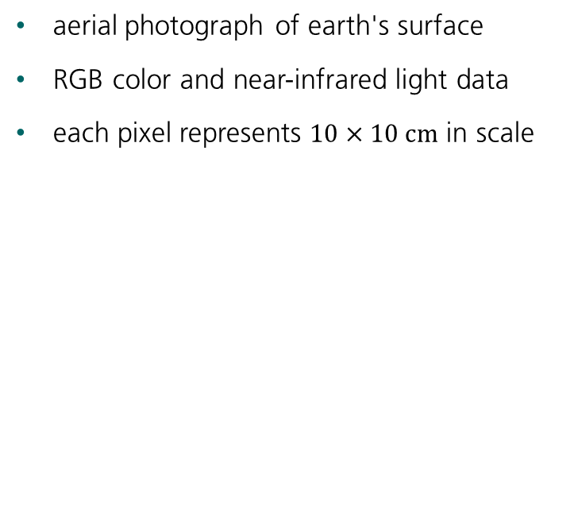
Digital Orthographic Photographs
aerial photograph of earth's surface
RGB color and near-infrared light data
each pixel represents $10×10 cm$ in scale
30 m
RGB Color
NIR values

Slide 21
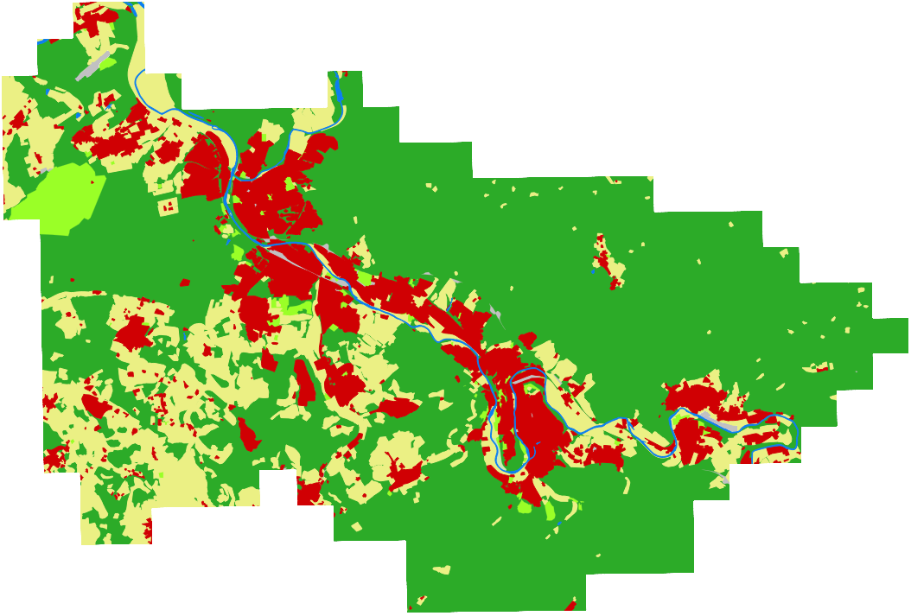
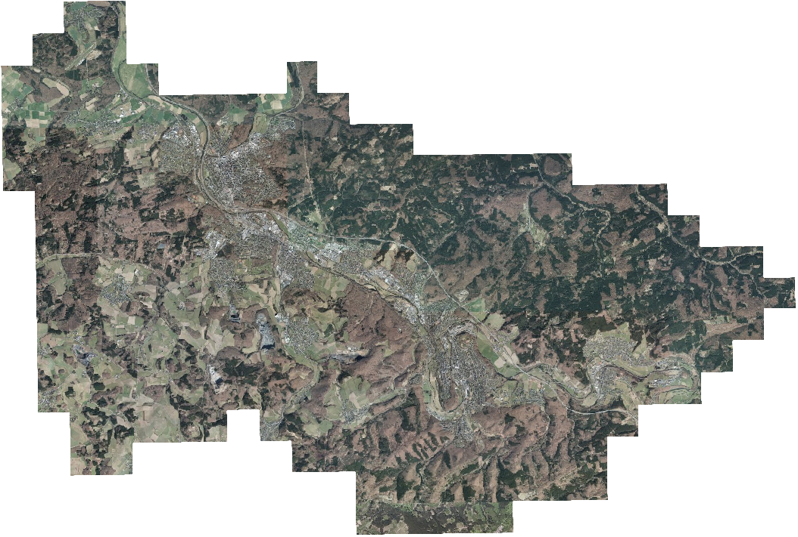
Raw Image Data
Total Area: 248.49 km²

Slide 22
Vector Graphics with Land Use
water
buildings
agriculture
forest
urban greens
traffic

Slide 23
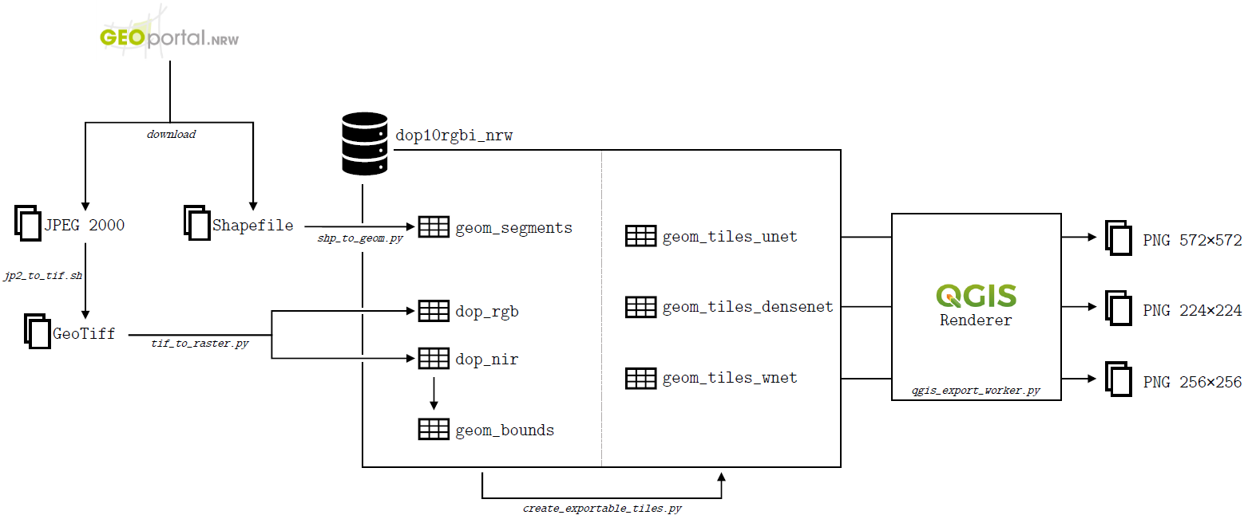
Data Preparations

Slide 24
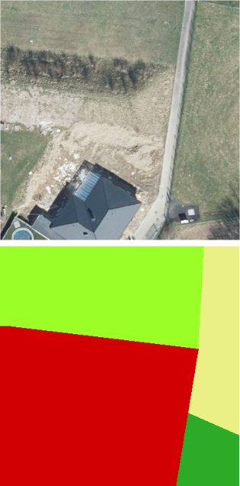
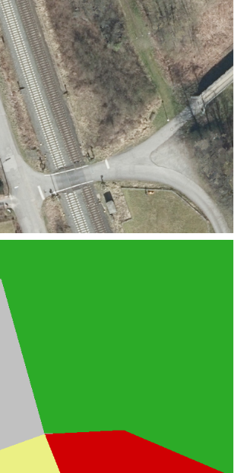
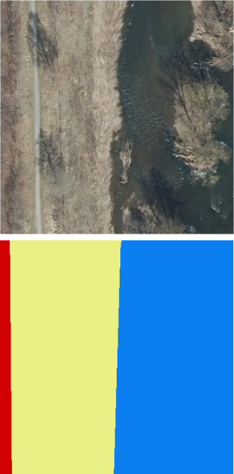
Inaccuracies in the Labels
buildings class includes land parcels
roads and railways submerged in surrounding class
riverbanks delineated poorly

Slide 25
Class Imbalance
forest, agriculture and buildings make up 97% of all data
Many training samples only consist of one class
could not be compensated with class weights

Slide 26
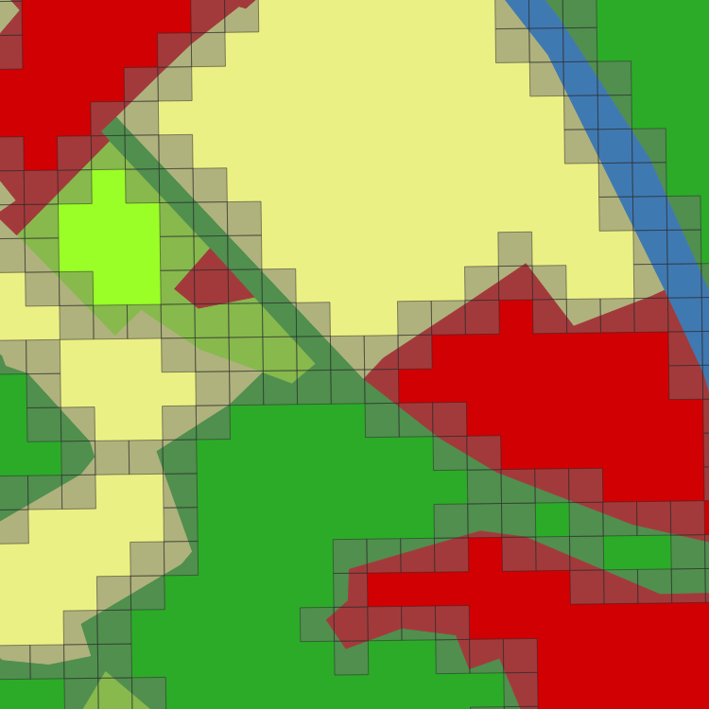
Class Imbalance – Addressing the Issues
only use samples containing two or more classes
focus on differentiation of classes
reduces class imbalance, because large patches are dropped
Notes:
forest 61,64%
buildings 13,53%
urban greens 2,53%
agriculture 20,86%
water 0,97%
traffic 0,48%

Slide 27
Final Datasets
U-Net
572x572 pixels
20,289 training images
4,679 test images
FC-DenseNet
224x224 pixels
38,367 training images
8,512 test images
W-Net
256x256 pixels
32,861 training images
7,405 test images

Slide 28
Image Segmentation
Experiments
Faculty of Mathematics and Computer Science
Karsten Köhler, Student ID No. 8690570

Slide 29



Implementation and Hardware Specifications
Intel Core i7 8700K 6x3.70 GHz
DDR4-2400 RAM, 32 GB
GeForce GTX 1080 Ti, 11 GB VRAM
Samsung SSD 860 EVO, 500 GB
Windows 10, Version 2004

Slide 30
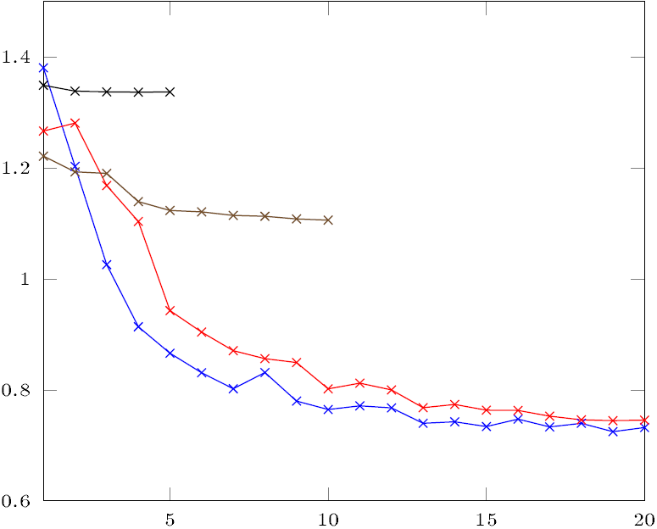
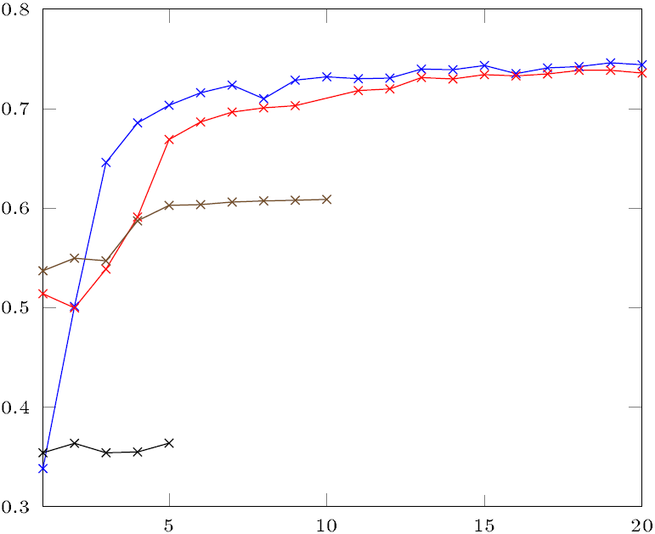
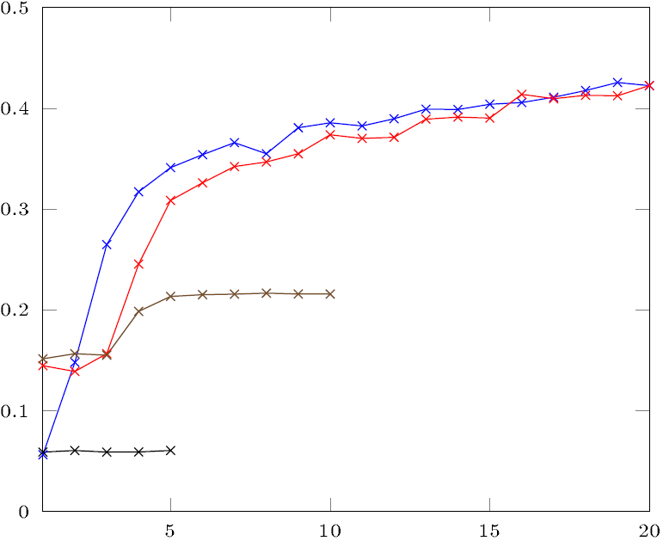
U-Net Metrics
Loss
 | Parameters (M) | Epochs | Loss | Cat. Accuracy (%) | Mean IoU (%)
Model
U-Net-23D | 16.6 | 20 | 0.7324 | 74.4 | 42.3
U-Net-23 | 16.6 | 20 | 0.7458 | 73.6 | 42.3
U-Net-18D | 4.3 | 10 | 1.1061 | 60.9 | 21.6
U-Net-28D | 16.5 | 5 | 1.3370 | 36.4 | 6.0
Cat. Accuracy
Mean IoU

Slide 31
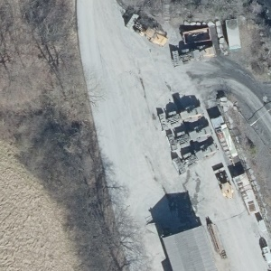
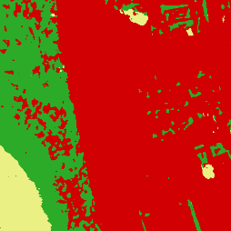

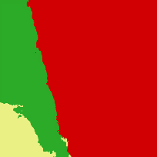
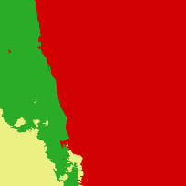

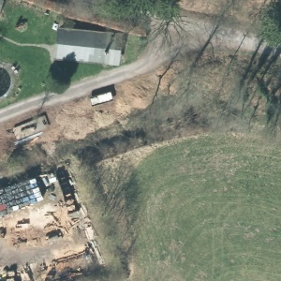
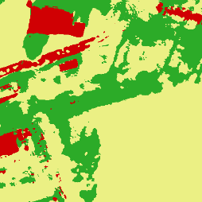








U-Net Predictions with Mean IoU
29.8%
40.0%
4.5%
20.9%
37.5%
61.8%
21.0%
33.4%
24.0%
37.9%
4.7%
18.0%
Original Image
Ground Truth
U-Net-23D
U-Net-23
U-Net-18D
U-Net-28D
(38.8 m edge length)

Slide 32



FC-DenseNet Metrics
Loss
 | Parameters (M) | Epochs | Loss | Cat. Accuracy (%) | Mean IoU (%)
Model
FCDN-103D | 10.8 | 20 | 1.1681 | 62.6 | 28.4
FCDN-103CD | 5.9 | 20 | 1.2952 | 55.9 | 24.0
FCDN-67D | 4.0 | 20 | 1.3301 | 53.7 | 23.2
FCDN-56D | 2.7 | 20 | 1.2806 | 56.1 | 21.8
Cat. Accuracy
Mean IoU

Slide 33


















FC-DenseNet Predictions with Mean IoU
56.0%
21.3%
15.6%
24.2%
50.6%
18.9%
16.2%
22.0%
26.9%
31.1%
30.1%
29.8%
Original Image
Ground Truth
FCDN-103D
FCDN-103CD
FCDN-67D
FCDN-56D
(22.4 m edge length)

Slide 34

W-Net Metrics
Loss
 | Parameters (M) | Epochs | Loss
Model
W-Net-36D-6 | 8.6 | 1 | 1.5142
W-Net-46D-6 | 33.3 | 1 | 1.5154
W-Net-36D-20 | 8.6 | 1 | 1.5137
W-Net-46D-20 | 33.3 | 1 | 1.5142

Slide 35



W-Net Class and Restoration Predictions
Original Image
W-Net-36D-6
W-Net-46D-6
(25.6 m edge length)

Slide 36


W-Net Class and Restoration Predictions
Original Image
W-Net-36D-20
W-Net-46D-20
(25.6 m edge length)

Slide 37
Image Segmentation
Discussion
Faculty of Mathematics and Computer Science
Karsten Köhler, Student ID No. 8690570

Slide 38








Discussion – U-Net vs. FC-DenseNet
Original Image
Ground Truth
U-Net-23D
FCDN-67D
U-Net-23D
coarse predictions
processing time: 9 seconds
FCDN-67D
fine-grained predictions
processing time: 11 seconds
36.3%
22.9%
41.7%
26.9%
(580 m edge length)

Slide 39
Discussion
W-Net performed very poorly
try semi-supervised learning
good predictions from U-Net and FC-DenseNet
predicitions can be further improved
ground truth needs to be more accurate
more balanced dataset would be beneficial

Slide 40
Vegetation Analysis
Literature Review
Faculty of Mathematics and Computer Science
Karsten Köhler, Student ID No. 8690570

Slide 41

Spectral Vegetation Indices
vegetation reflectance
indicate vegetation health and density
based on reflectance in electromagnetic spectrum
various indices available
near-infrared
green
blue
red
400 nm
450 nm
500 nm
550 nm
600 nm
650 nm
700 nm
← ultraviolet
visible light
infrared →

Slide 42
Vegetation Analysis
Experiments
Faculty of Mathematics and Computer Science
Karsten Köhler, Student ID No. 8690570

Slide 43





Ratio Vegetation Index (RVI)
Original Image
RVI
20
$$RVI= \frac{NIR}{Red}$$
10
Properties
lower limit is 0
no upper limit
0

Slide 44



Normalized Difference Vegetation Index (NDVI)
Original Image
NDVI
+1
$$NDVI= \frac{NIR−Red}{NIR+Red}$$
0
Properties
limited to range -1 to +1
< 0 is mostly water
-1

Slide 45



Enhanced Vegetation Index (EVI)
Original Image
EVI
+1
$$EVI=G⋅\frac{NIR−Red}{NIR+C_{1}⋅Red−C_{2}⋅Blue+L}$$
$$G=2.5; C_{1}=6;C_{2}=7.5;L=1$$
0
Properties
limited to range -1 to +1
< 0 is mostly water
-1

Slide 46




Soil-Adjusted Vegetation Index (SAVI)
Original Image
SAVI
20
$$SAVI=\left(\frac{NIR−Red}{NIR+Red+L}\right)⋅\left(1+L\right)$$
$$L=0.5$$
10
Properties
takes soil variations into account
0

Slide 47



Modified Soil-Adjusted Vegetation Index (MSAVI)
Original Image
MSAVI
80
$$MSAVI=\frac{2NIR+1−\sqrt{{\left(2NIR\right)}^{2}−8(NIR−Red)}}{2}$$
40
Properties
automatically adjusted based on soil variations
0

Slide 48
Vegetation Analysis
Discussion
Faculty of Mathematics and Computer Science
Karsten Köhler, Student ID No. 8690570

Slide 49





Discussion
vegetation indices yield contradictory results
reliable predictions are virtually impossible
?
RVI
NDVI
EVI
SAVI
MSAVI
Vegetation Density Prediction

Slide 50
Discussion
optimized for very specific set of hardware
only green vegetation, no dead vegetation, no other obstacles
no information about height and robustness
is subject to frequent changes
Recommendation
With the present results, vegetation indices cannot be used in a reliable way. Further research on this topic is required.

Slide 51
Conclusion
Supervised learning was good, U-Net and FC-DenseNet can both be used, Further improvements possible
Desicion if rough or fine segmentations
Not more data, but more accurate labels, maybe other regions of world
Vegetation indices are OK, but not as standalone factor
No recommendation of which one to use, depending on sensor etc

